Slide 1
Comparative Efficiency Analysis of Conventional and Islamic Insurance Companies in MENA Region.
Authors : Rasha M Obaid
Masters in Islamic Finance Student,
Effat University, Jeddah
&
Dr. Rozina Shaheen
Assistant Professor, College of Business,
Effat University, Jeddah

Slide 2
Outline
Introduction
Background/Literature Review
Research Question(s)
Research Methods
Findings/Data
Discussion/Conclusion(s)
Future Research
References
Questions

Slide 3
Motivation and Background
Insurance companies have importance both for businesses and individuals as they indemnify the losses and put them in the same positions as they were before the occurrence of the loss.
In addition, insurers provide economic and social benefits in the society i.e. prevention of losses, reduction in fear and increasing employment.

Slide 4
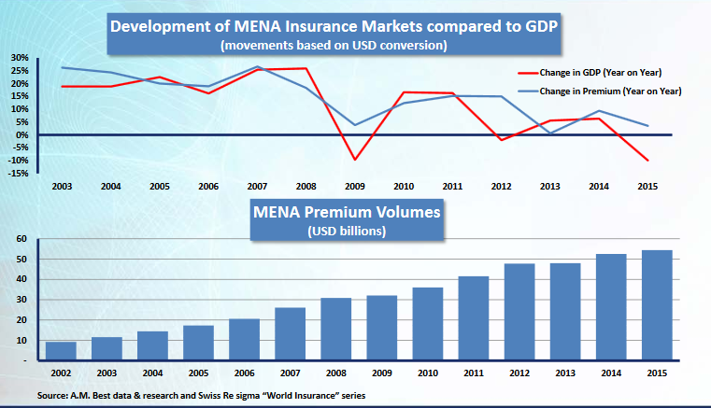
Insurance Industry in MENA Region

Slide 5
Takaful Versus Conventional Insurance
Insurance
Insurance is a contract between two parties, whereby one party agrees to undertake the risk of another in exchange for consideration known as premium, and promises to pay a fixed sum of money to the other party on happening of an uncertain event or after the expiry of a certain period. The party bearing the risk is known as the insurer. The party whose risk is covered is known as the insured.
Takaful
Takaful is based on the principle of Ta’awun (Mutual Assistance) and Tabarru’(Gift, Give away, Donation), where the risk is shared collectively by the group voluntarily. This is a pact among a group of members or participants who agree to jointly guarantee among themselves protection against loss or damage to any of them as defined in the pact

Slide 6
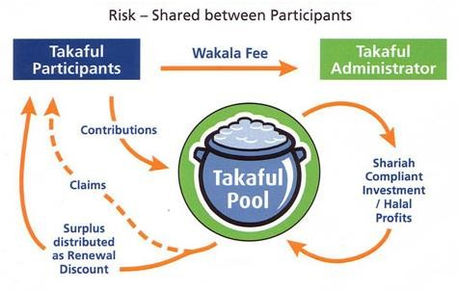
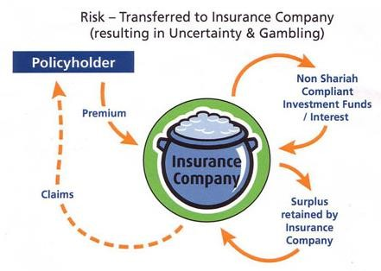
Takaful Versus Conventional Insurance

Slide 7
Research Objective(s)
The main objective of this research is to examine and compare the efficiency (technical, scale and productive )of conventional and Islamic insurance companies(Takaful) in MENA Region for the sample period 2012 to 2016.

Slide 8
Related Literature
Authors | Title
Hidayat, S. E., & Abdulla, A. M. (2015). | A comparative analysis on the financial performance between takaful and conventional insurance companies in Bahrain
Abdou, Ali and Lister (2014) | A comparative study of Takaful and conventional insurance: empirical evidence from the Malaysian market
Miniaoui and Chaibi (2014) | “Technical efficiency of takaful industry: A comparative study of Malaysia and GCC countries”
Atiq, Uzma (2014) | "Efficiency measures of insurance vs. Islamic insurance firms using DEA approach: A case of Pakistan"
Mohd et al.(2012) | “A study on takaful and conventional insurance preferences: The case of Brunei”
Swartz, N. P., & Coetzer, P. (2010). | Takaful: an Islamic insurance instrument
Kader, H.A., Adams, M. and Hardwick, P. (2010), | “The cost efficiency of Takaful insurance companies”.
Hafiza, Zeeshan (2014) | Comparative performance of islamic and conventional insurance companies Pakistan"

Slide 9
Methodology
This study estimates the technical, scale and productive efficiency for the selected sample while using “Data Envelopment Analysis (DEA)”, covering the time period 2012 till 2016.
Data Envelopment Analysis (DEA) measures the relative efficiencies of organizations with multiple inputs and multiple outputs. The organizations are called the decision-making units, or DMUs.
Efficiency is defined as the ratio of weighted sum of outputs to weighted sum of inputs and a DMU is considered efficient if it achieves a score of 1.00

Slide 10
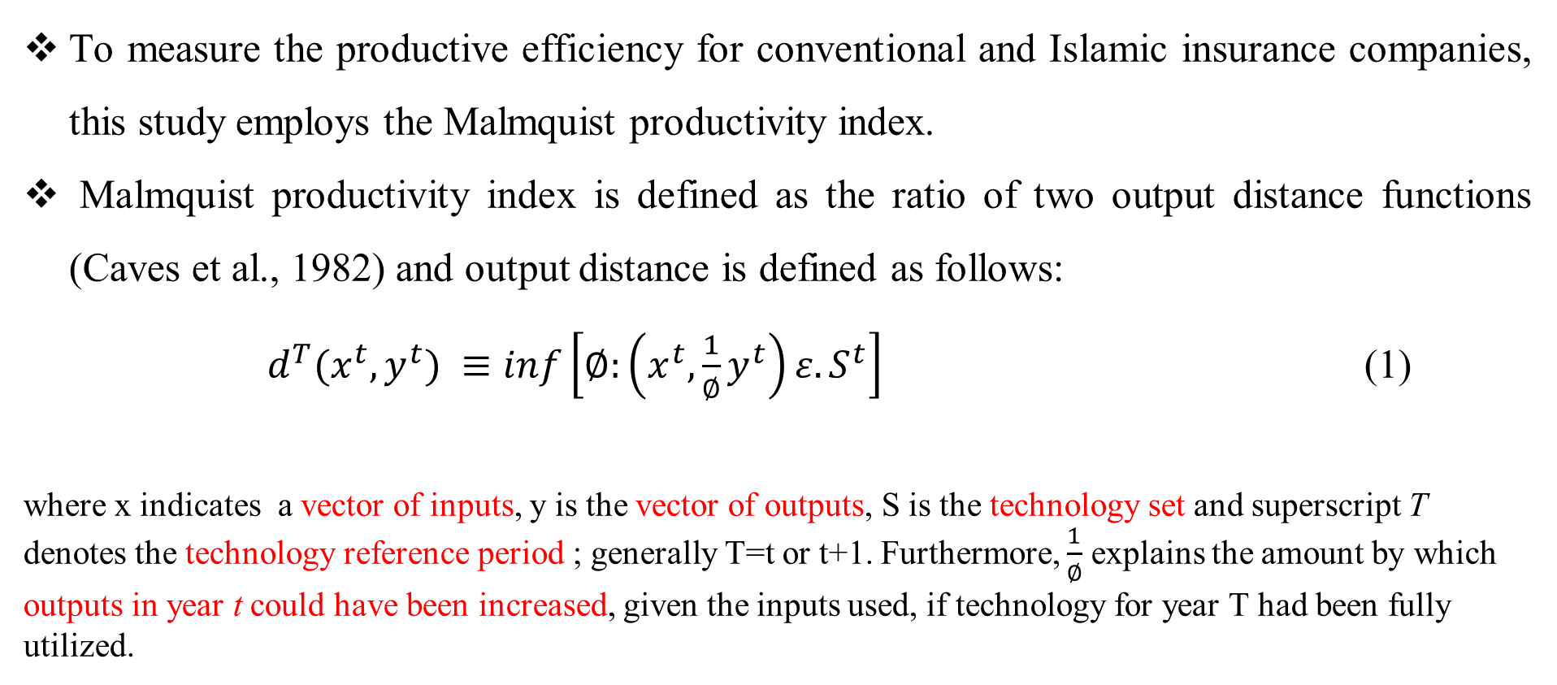
Malmquist Productivity Index
To measure the productive efficiency for conventional and Islamic insurance companies, this study employs the Malmquist productivity index.
Malmquist productivity index is defined as the ratio of two output distance functions (Caves et al., 1982) and output distance is defined as follows:
$d^{T}(x^{t},y^{t}) ≡inf\left[∅:\left(x^{t},{\frac{1}{∅}y}^{t}\right)ε.S^{t}\right]$ (1)
where x indicates a vector of inputs, y is the vector of outputs, S is the technology set and superscript T denotes the technology reference period ; generally T=t or t+1. Furthermore, $\frac{1}{∅}$ explains the amount by which outputs in year t could have been increased, given the inputs used, if technology for year T had been fully utilized.

Slide 11
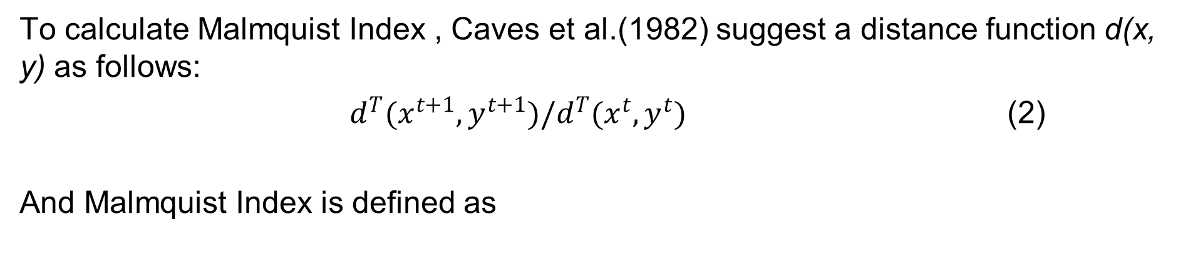
Methodology
To calculate Malmquist Index , Caves et al.(1982) suggest a distance function d(x, y) as follows:
$d^{T}(x^{t+1},y^{t+1})/d^{T}(x^{t},y^{t})$ (2)
And Malmquist Index is defined as
(3)
Equation (3) represents the productivity of the production point relative to the production point .
A value greater than one will indicate positive total factor productivity (TFP) growth from period t to t+1.

Slide 12
Malmquist Productivity Index
(4)
Efficiency
Change
Technical Change
(5)
Technical Change
Efficiency
Change
Scale Efficiency Change

Slide 13
Selection of Input-outputs and Sample
Inputs : commission paid and management expenses
Outputs: insurance premium and net investment income
Sample : a panel of 40 conventional and 40 Islamic insurance companies
Sample period : 20012 to 2016.

Slide 14
Estimation and Results
Table 1. Descriptive Statistics - Conventional Insurance Companies
Table 2. Descriptive Statistics - Islamic Insurance Companies
 | Premium | Net Investment Income | Commission | Management Expenses
Mean | 65762.4 | 6234.5 | 5577.1 | 14080.4
Median | 31931 | 2781 | 3945.5 | 6297
Std Dev. | 106840.9 | 7948.1 | 9585.2 | 18561.8
Minimum | 1080 | -7787 | -24213 | 148
Maximum | 849420 | 36828 | 48191 | 89593
 | Output |  | Input
 | Premium | Net Investment Income | Commission | Management Expenses
Mean | 55654.9 | 1,080 | 3945.3 | 13623.3
Median | 42560 | 79 | 3214.5 | 12104
Std dev. | 57920.6 | 2266.3 | 4649.2 | 11104.6
Minimum | -190 | -12,919 | -12114 | -662
Maximum | 560209 | 14,328 | 17683 | 69165

Slide 15
Average Efficiency Scores
 | Technical Efficiency Change | Technological Efficiency Change | Pure Efficiency Change | Scale-efficiency Change | Total Factor Productivity Change
Conv. Insurance Firms | 0.580 | 1.88 | 0.845 | 0.688 | 0.996
Islamic Insurance Firms | 1.172 | 1.101 | 1.417 | 1.027 | 1.172
Technical Efficiency Change : incorporates the best practice technology in the management of activity and it includes; technical experience, investment planning, organization, and management in the entity
Technological Efficiency Change:caused by innovative practices, investment in new technologies (methodologies, procedures, and techniques) and in the development of skills relevant to insurance industry
Pure Efficiency Change: indicates an improvement in organisational factors which include; development in managerial skills, better balance between inputs and outputs, best-practice initiatives, more accurate reporting, an improvement in quality and so on .
Scale-efficiency Change : a firm is operating at it's "optimal size.
Total Factor Productivity Change : productivity change

Slide 16
Conclusion
This research finds:
That Islamic insurance firms are more technically efficient both in terms of pure technical efficiency and scale efficiency whereas conventional insurance are more efficient to bring technological change in the industry.
Also Islamic insurance firms observe more gains in productivity than conventional insurance firms in MENA region during the sample period
For conventional insurance firms in MENA region, most of the productivity growth comes from technological change whereas for Islamic insurance companies, most of the productivity changes are enhanced through technical efficiency.

Slide 17
Thanks

