Slide 1
Estimating the Income Distribution of Some Islamic Countries Based on Entropy Measures
Omar Kittaneh

Slide 2


Slide 3
Government Regulations

Slide 4
Government Regulations
Lack of Opportunity to All

Slide 5
Government Regulations
Lack of Opportunity to All
Land and Wealth Disputes

Slide 6
Government Regulations
Lack of Opportunity to All
Land and Wealth Disputes
Lack of Education and the Caste System

Slide 7
Government Regulations
Lack of Opportunity to All
Land and Wealth Disputes
Lack of Education and the Caste System
Unfair Practices of Political Systems

Slide 8
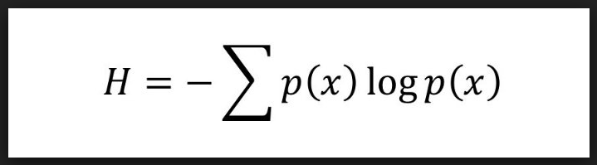
Entropy (Shannon 1948)

Slide 9
The Income Distribution

Slide 10



Saudi Arabia
United Arab Emirates
Egypt

Slide 11
The Maximum Entropy Distribution
(Jaynes 1957)

Slide 12
The Distribution That Maximizes
Shannon Entropy

Slide 13
Subject to the Minimum Available Information such as the Average Income.

Slide 14
According to the World Bank and International Monetary Fund

Slide 15
The Average Income in the three Countries are as follows:
Saudi Arabia =1725 $
United Arab Emirates= 3235 $
Egypt=165 $

Slide 16
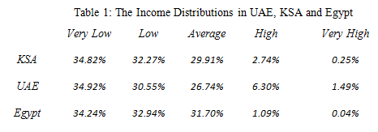

Slide 17
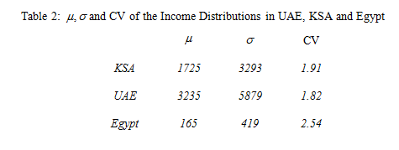

Slide 18
Egypt has the most dispersed income distribution.
The income distributions of KSA and UAE have almost the same features.

